Slide 1
Adding materials to OghmaNano
This tutorial covers adding extra materials to the OghmaNano materials database.
Dr. Roderick MacKenzie
roderick.mackenzie@oghma-nano.com
Autumn 2022
https://www.Oghma-Nano.com

Slide 2
Outline
Introduction to the materials database in OghmaNano
Where is the materials database stored?
What format is the materials database stored in?
Adding your own material the hard way.
Where do I get refractive index information from?
Extracting n/k data from the literature.
Using the graphical interface to import data.
Other information contained within the materials database.

Slide 3
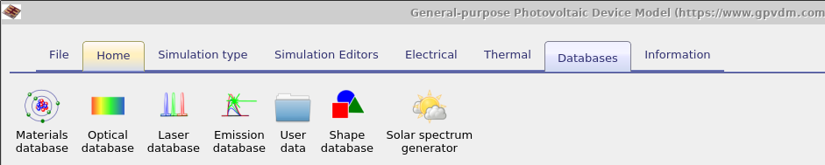
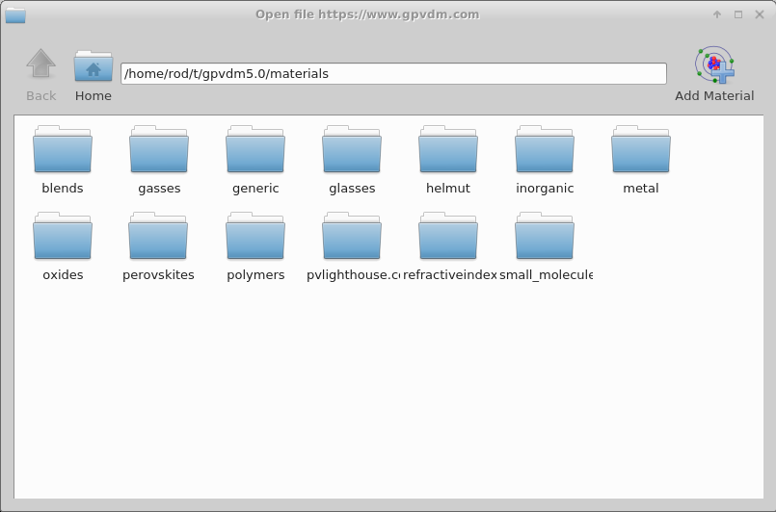
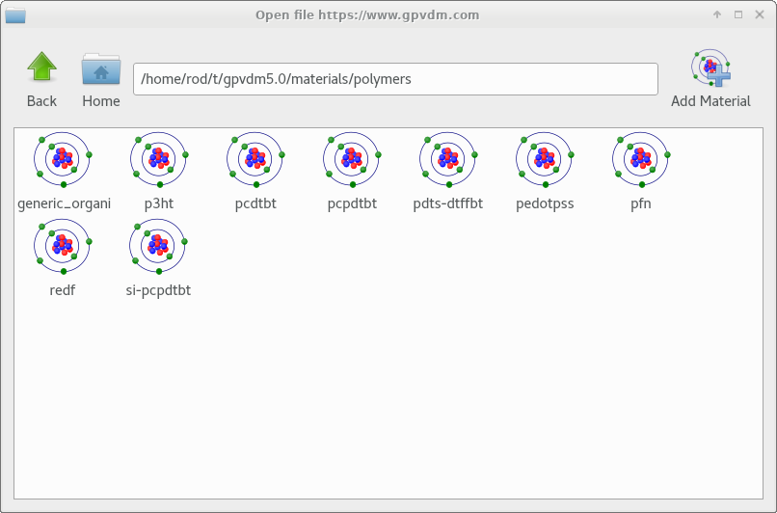
Introduction 1/3
The materials database stores mainly the optical (n/k) data for the materials used in OghmaNano simulations. You can access it from the database tab.

Slide 4
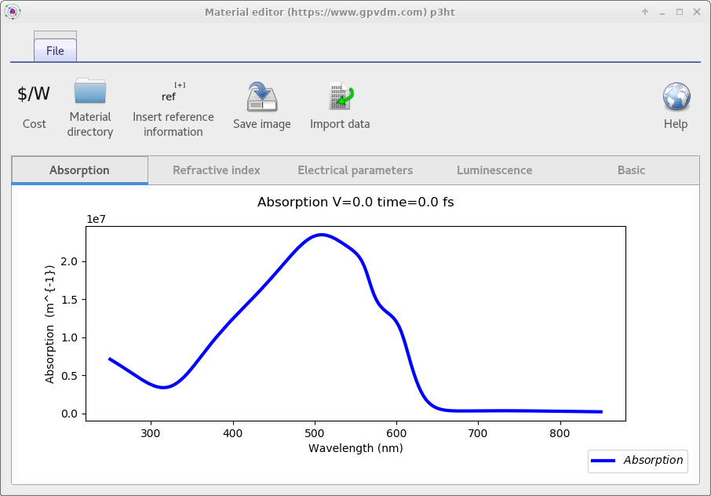
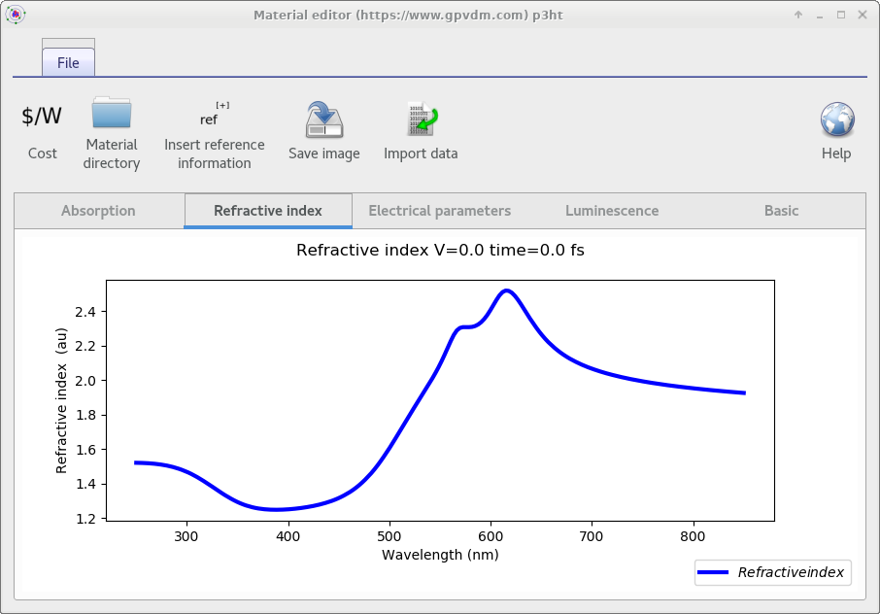
Introduction 2/3
Each material has n/alpha data stored for it.

Slide 5
Introduction 3/3
Although the materials database does store some electrical parameters and thermal parameters these are not used in the simulations.
This is because OghmaNano is mainly used for simulating thin film devices, and the material parameters change a lot between fabrication runs/labs/material batches. Therefore electrical/thermal parameters have to be set in the simulation it’s self.
The materials database is mainly used for storing n/k data which is used in simulations.

Slide 6
Outline
Introduction to the materials database in gpvdm
Where is the materials database stored?
What format is the materials database stored in?
Adding your own material the hard way.
Where do I get refractive index information from?
Extracting n/k data from the literature.
Using the graphical interface to import data.

Slide 7
Where is the materials database stored on my computer?
The materials database is stored in your home directory within the oghma_local folder. So for the user ‘Rod’ it would be stored in:
  c:\Users\Rod\oghma_local\materials
If your home directory is stored on a network or somewhere else the materials directory would be stored in:
  ‘the path to your home folder’\oghma_local\materials
Where ‘the path to your home folder’ would represent the path to your home folder where ever it may be stored.

Slide 8
Outline
Introduction to the materials database in OghmaNano
Where is the materials database stored?
What format is the materials database stored in?
Adding your own material the hard way.
Where do I get refractive index information from?
Extracting n/k data from the literature.
Using the graphical interface to import data.

Slide 9
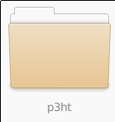
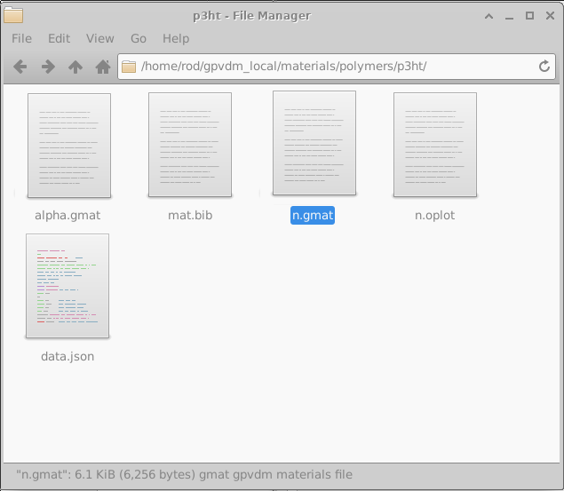
What format are the materials stored in?
Each material is stored in it’s own directory in the materials directory, so for example p3ht is stored in the directory p3ht:
In each materials directory there are 4 files:
alpha.csv: Contains the optical absorption information
n.csv: contains the real part of the refractive index
bat.bib: Is a bib file containing references.
data.json contains all other information about the material in JSON format.
These are all text files you can edit them directly with a text editor.

Slide 10
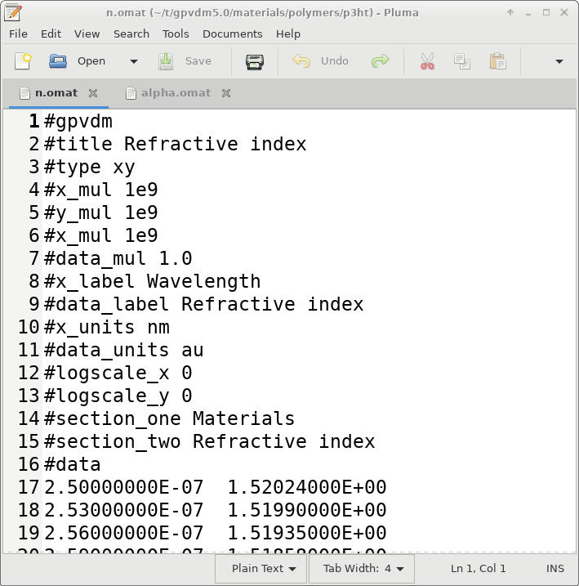
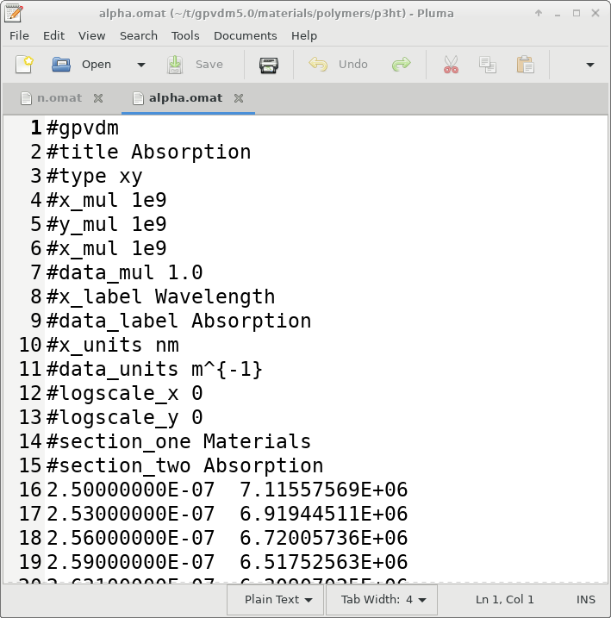
n.omat and alpha.omat files look like this...
n.csv
alpha.csv
There is a header which you can leave alone, then there are two columns:
n.csv: wavelength (meters) / refractive index
alpha.csv: wavelength (meters) / Absorption in (m⁻¹)
Again these are text files you can edit them by hand.

Slide 11
Outline
Introduction to the materials database in gpvdm
Where is the materials database stored?
What format is the materials database stored in?
Adding your own material the hard way.
Where do I get refractive index information from?
Extracting n/k data from the literature.
Using the graphical interface to import data.

Slide 12
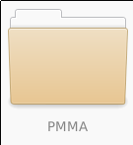
Adding your own material the hard way...
Simply copy an existing material directory to a new one say copy p3ht to a new directory called PMMA.
Then copy and paste the refractive index/absorption information into alpha.gmat and n.gmat.
Make sure you use the correct units i.e. wavelength (m) and absorption in m⁻¹.
That’s it.
It will not work if you use cm or um for wavelength, and absorption must be in m⁻¹.

Slide 13
Outline
Introduction to the materials database in gpvdm
Where is the materials database stored?
What format is the materials database stored in?
Adding your own material the hard way.
Where do I get refractive index information from?
Extracting n/k data from the literature.
Using the graphical interface to import data.

Slide 14
Getting hold of refractive index absorption data.
There are lots of places to get hold of refractive index data:
  1. Your own experiments – this is the best option.
  2. https://refractiveindex.info This is a very good site containing lots of refractive index information.
  3. https://www.pvlighthouse.com.au/ another good site with n/k data.
  4. Extract the n/k data from the literature.

Slide 15
Outline
Introduction to the materials database in gpvdm
Where is the materials database stored?
What format is the materials database stored in?
Adding your own material the hard way.
Where do I get refractive index information from?
Extracting n/k data from the literature.
Using the graphical interface to import data.
Other information contained within the materials database.

Slide 16
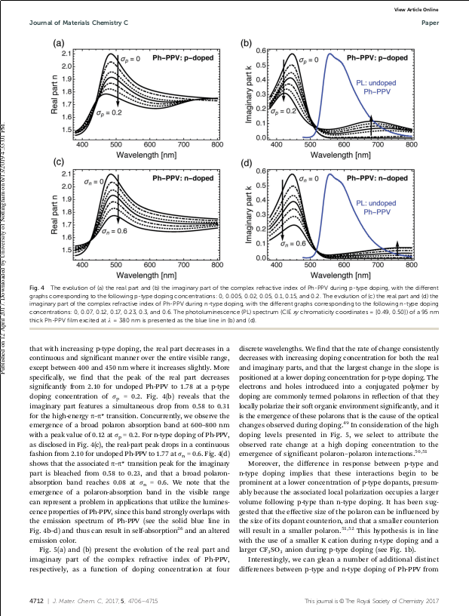
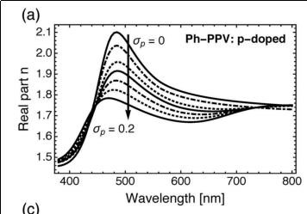
Extracting n/k data from the literature
Step 1: Find a paper with the refractive index/absorption data in it (hint: Try google image search for this)
Step 2: Take a screenshot of the graph you want to import, and save it as a .png file.
Pdf of paper
Graph saved as png.

Slide 17
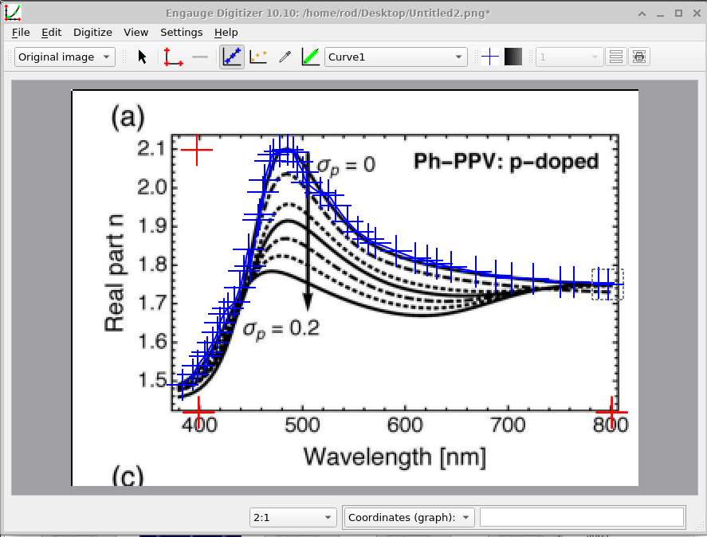
Extracting n/k data from the literature
Step 3: Download Engauge Digitizer from the internet:
  http://markummitchell.github.io/engauge-digitizer/
Step 4: Set up the axies (red crosses), then by hand draw points on the the data you want to extract.
Step 5: Save this data as:
Wavelength(m) v.s. n
or
Wavelength(m) v.s. absorption (m⁻¹)
Step 6: Copy and paste this data into your n.gmat or alpha.gmat files.

Slide 18
Outline
Introduction to the materials database in OghmaNano
Where is the materials database stored?
What format is the materials database stored in?
Adding your own material the hard way.
Where do I get refractive index information from?
Extracting n/k data from the literature.
Using the graphical interface to import data.
Other information contained within the materials database.

Slide 19
Adding a material using the graphical interface
Select the materials directory to which you want to add a material to then click Add material.

Slide 20
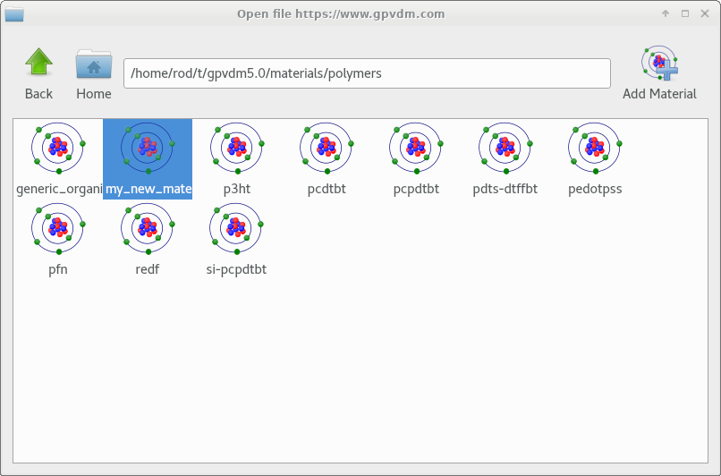
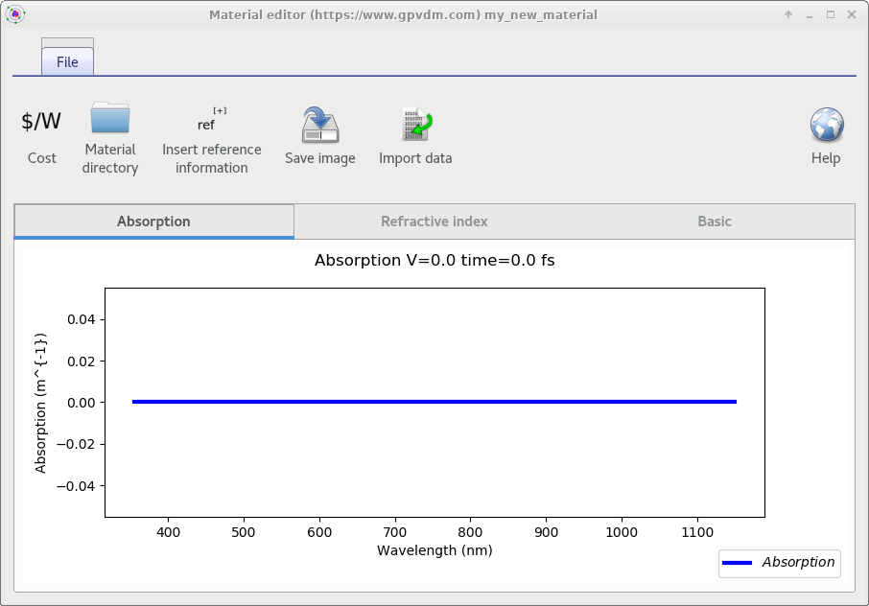
Making a new material the easy way...
1. Click
2. Double click
The material file has no data….

Slide 21
Adding a material using the graphical interface
Click import data, and the data importer window will be displayed….

Slide 22
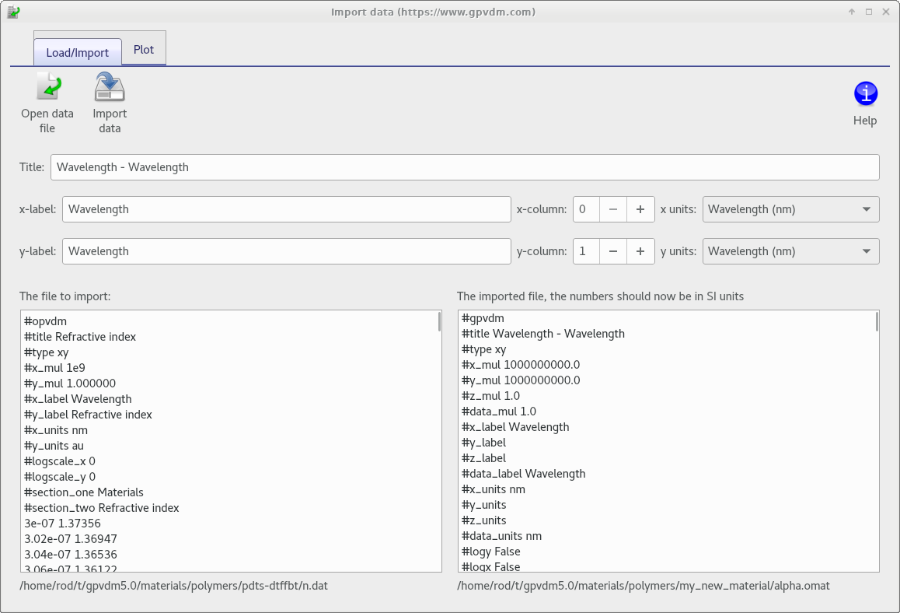
Click open data file...
And select the data file containing your n/k data.
See earlier on in the slide deck to find out how to get n/k data.

Slide 23
The import window used to convert data to SI
Set these to the units of the input file.
Note this can transform between absorption units.
The imported data
The the data transformed into SI, ready to be imported into gpvdm.
So if your file were in units of wavelength nm and absorption ‘attenuation coefficient’, select those.

Slide 24
Then click import data and the data will be imported into the new material..

Slide 25
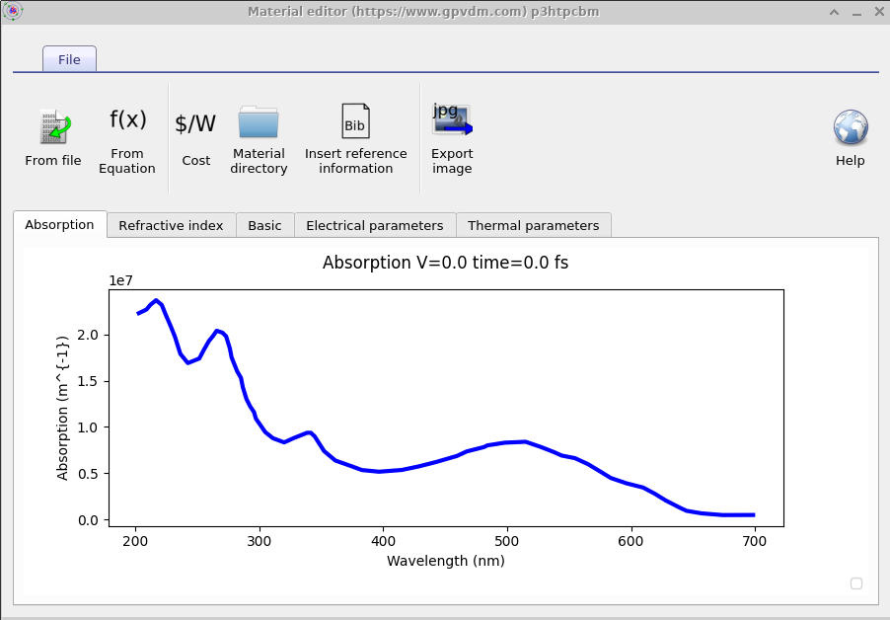
And you will have imported your data..
You will need to do this for both the Absorption and the real part of the refractive index.

Slide 26
Overview
Introduction to the materials database in OghmaNano
Where is the materials database stored?
What format is the materials database stored in?
Adding your own material the hard way.
Where do I get refractive index information from?
Extracting n/k data from the literature.
Using the graphical interface to import data.
Other information contained within the materials database.

Slide 27
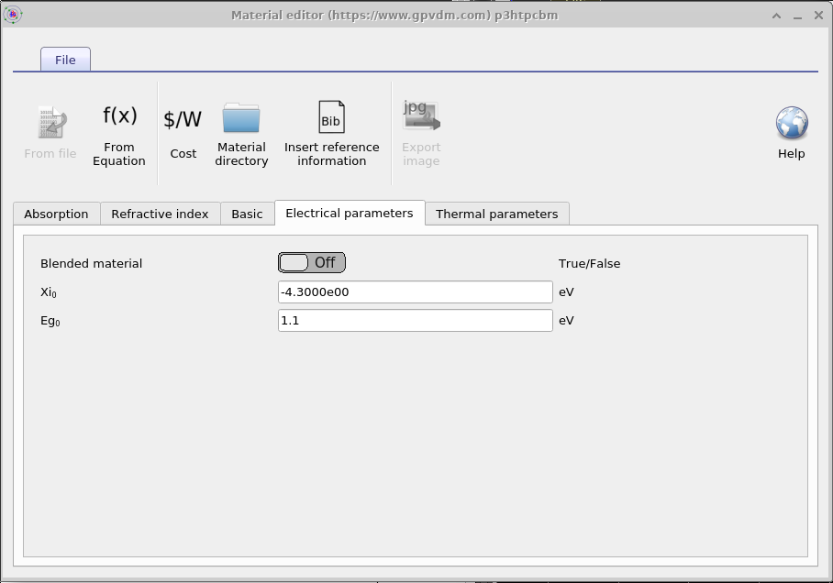
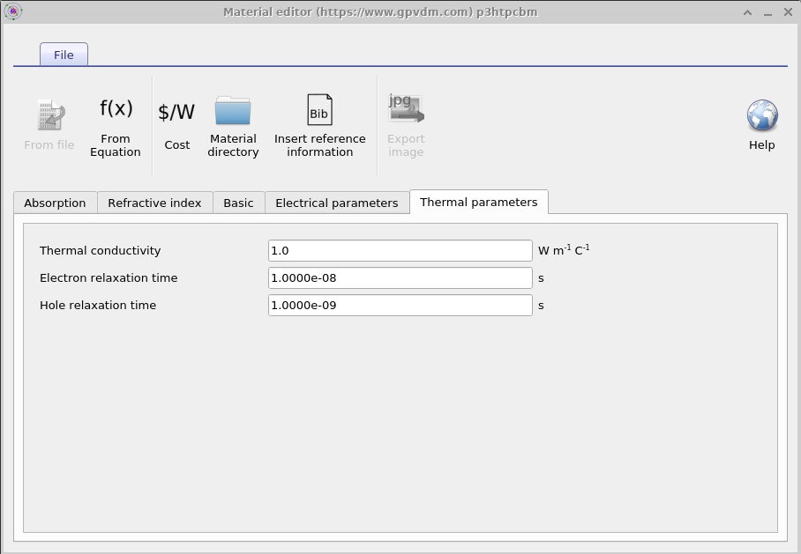
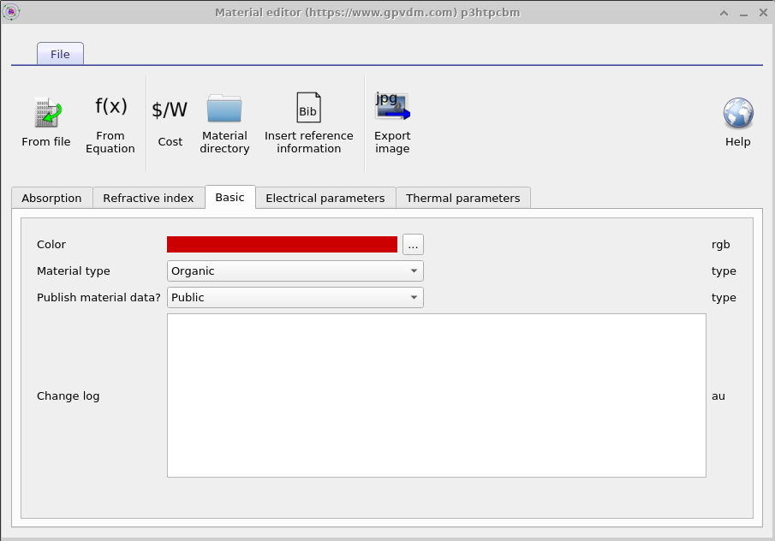
The materials database contains:
Basic information
Basic Electrical information
Thermal information

Slide 28
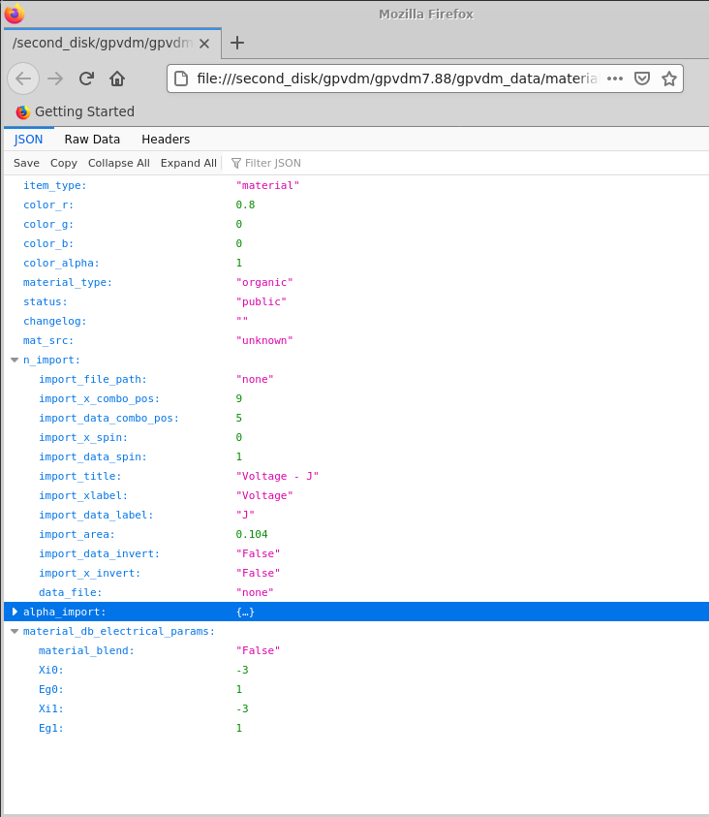
All other material data is stored in the data.json
These are stored in the data.json file
This can be viewed in firefox, or in a text editor.

Slide 29
Basic electrical information
Because OghmaNano is mainly used to simulate thin film devices, and because the quality of thin films changes a lot between devices/labs/fabrication runs, it does not make sense to have a database of electrical parameters for materials such as P3HT.
Therefore the electrical parameters should be set in the electrical parameters window in your simulation, not in the materials database.
The values in this window are simply use for drawing pretty band diagrams, and are not used in the simulation.

Slide 30
Basic information
This contains basic information about the material, such as it’s color and material type, metal/oxide/polymer etc...

Slide 31
Thermal information
These values are used as the default values for thermal simulations.

